Slide 1
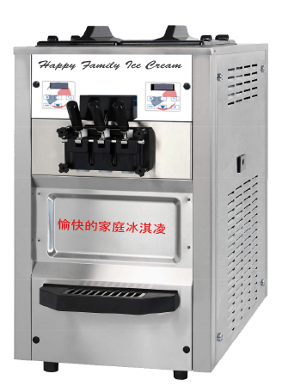
Happy Family Ice Cream Machines
Magpie Trading Company

Slide 2
Ice Cream Machines From China Cost Less
The market need/gap is that buyers want to buy commercial soft serve ice cream machines for less than the price of those being sold in the USA.
Equipment made and sold in China costs much less.
However, potential customers may not be familiar with importing, commercial language, or business customs in the USA, or may have a hard time with time zones and language barriers when reaching out to sales, support, and customer service people. An online store offering turnkey service in either language with a single point of contact would solve that problem. It will also be promoted as an Amazon.com Seller and an Ebay.com store. These big name partnerships will help create trust and loyalty for repeat business when this market segment is shopping online.

Slide 3
Buy With Confidence From Bi-Lingual Chinese American Business Owner
The company is owned by client Li Yong, a Chinese entrepreneur who is now a Naturalized Citizen of the USA. The client wants to start a company selling Chinese made commercial soft serve ice cream machines and other commercial food service machines to Chinese American buyers who own or manage a Convenience Store.
The market advantage for the client will be the ability to knowledgably source quality products from China and offer marketing copy, reviews, ratings, sales, support, installation, and customer service in the native language of both Chinese manufacturers and Chinese American customers. There will be a focus on building trust around Chinese brands with assurances that high quality goods will be stocked.

Slide 4
Competition
Competitors will include other online sellers of commercial food service equipment using Amazon.com and Ebay.com stores.
Sam’s club is another online competitor which also has brick and mortar outlets that cater to business owners.
Finally, regional distributors of food service equipment such as Burkett Restaurant Equipment may also compete in this category.
The Machine Brand will be Happy Family Ice Cream®

Slide 5
Value Proposition
Importing Chinese ice cream machines made easy
Bi-lingual integrated marketing communication
Single point of contact during the buying cycle
Customs Clearance, Transportation, Delivery, Setup Provided
Bi-Lingual service after the sale

Slide 6
Target Market
Convenience Stores Owned by Chinese Americans
Target Market Segment Details
Race is Asian |  |  |  |  | 100%
Country of Origin is China |  |  |  |  | 80%
Geographic Location is Midwest to East Coast |  |  |  |  | 100%
Age is 24-64 |  |  |  |  | 100%
Above Average Annual Household Income |  |  |  |  | 100%
Above Average Education |  |  |  |  | 100%
Internet Usage |  |  |  |  | 85%
Mobile Device / Smartphone Usage |  |  |  |  | 75%
Comfortable with Online Shopping |  |  |  |  | 65%

Slide 7
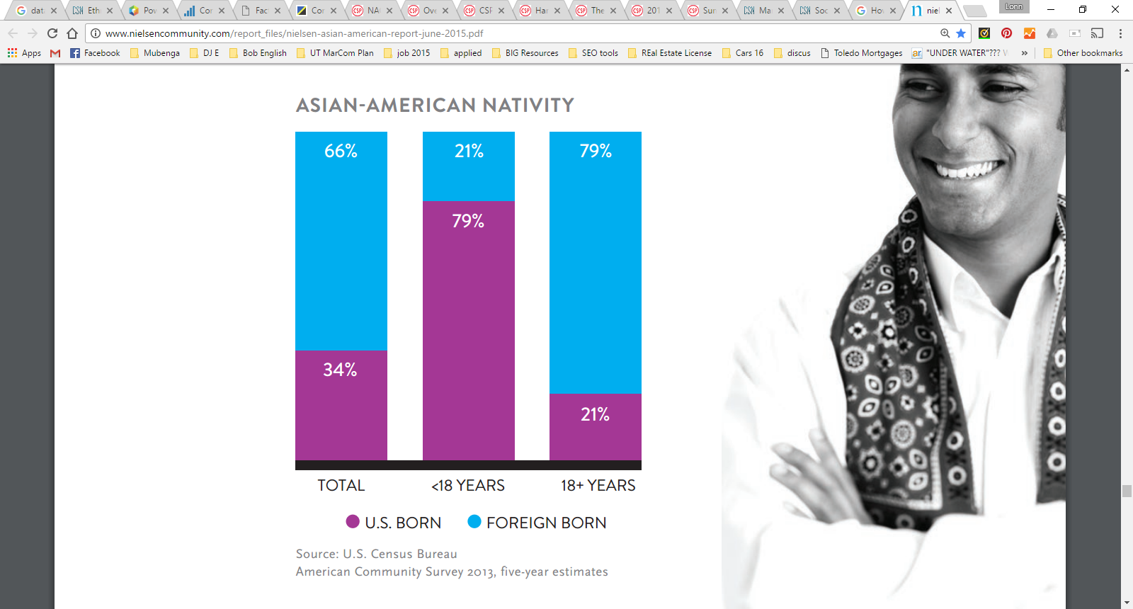
Most Chinese Americans Are Foreign Born
Source: U.S. Census Bureau American Community Survey 2013, five-year estimates

Slide 8
Convenience Stores Are A Growth Industry
(NACS; preliminary data 2015, www.cspdailynews.com).

Slide 9
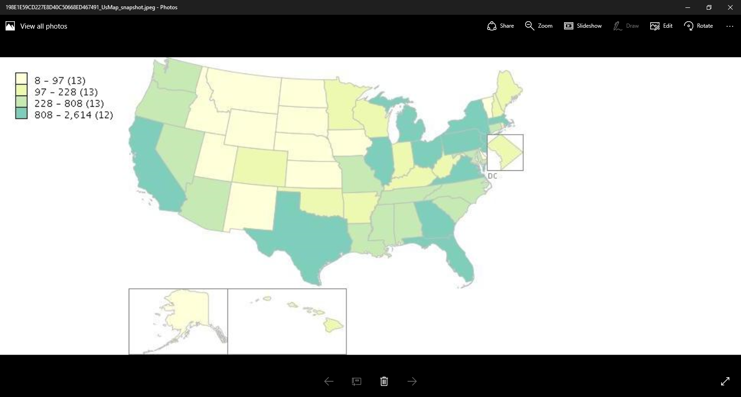
Regional Concentration of Convenience Stores
US Census Data, 2012, www.thedataweb.rm.census.gov,

Slide 10
Media Consumption Habits of Target Market
Chinese Americans watch less TV and consume more digital media than average for any other consumer group.
Nielsen Total Audience Report, Q4 2014

Slide 11
Startup And First Year Marketing Budget
MarCom Budget Line Items
Website Design and Web / Email Hosting |  |  |  |  | $2,000
Content / Copy For Web and Social Media |  |  |  |  | 2,000
Social Media Manager, Part Time |  |  |  |  | 2,000
Paid Placement On Search Engines |  |  |  |  | 2,000
Paid Ads on Social Media, Facebook & Twitter |  |  |  |  | 2,000

Slide 12
MarCom Channel Selection
Mobile First Website Design with SEO
The first step in the execution of a MarCom plan for Magpie will be to create a mobile device friendly official Magpie Trading Company website with Search Engine Optimization to obtain high ranked listings at famous search engine like Google, Being and Yahoo etc.
Paid Online Advertising
Other early efforts will go into paid placement on Google AdWords, Facebook, and Twitter. to increase brand awareness, positioning, frequency, repetition, share of market voice, and lead generation.

Slide 13
MarCom Channel Selection
Social Media
Further, Social Media pages and accounts such as Facebook.com and Twitter.com to build awareness, elicit conversations, build emailing lists or databases that support various methods of reaching prospects and customers with useful news and product offers as well as engaging content. Customers will be invited to send photos of the machines in their stores, and to share stories about their experience with the company and market segment.
Email Marketing
An email mailing list will be built from inquiries arriving from various online sources so that an email newsletter can be sent regularly.

Slide 14
MarCom Channel Selection
Blogs and Articles
Magpie will post to other popular blog and social media accounts with a focus on those owned or frequented by Chinese-Americans in order to increase market reach and build relationships with potential referral sources.
Other Internet Marketing
Magpie Trading Company will create an Amazon Store, and EBay Store, using integrated marketing communication strategy.

Slide 15
MarCom Channel Selection
Bi-Lingual MarCom List Building
Both the website and social media efforts will include both Chinese and English language messaging. If people subscribe to blogs or newsletters on the website, or like or follow social media pages or efforts they will be added to the prospect list with an automated private message with a short introduction about the company and website.
Prospects will be enticed to join our lists with an offer of a discount code which they can use on a future purpose.

Slide 16
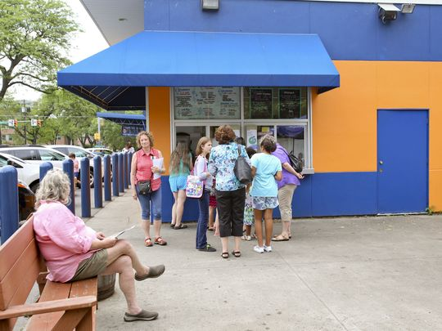
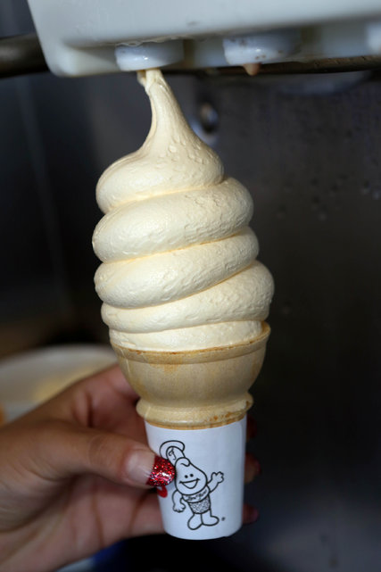
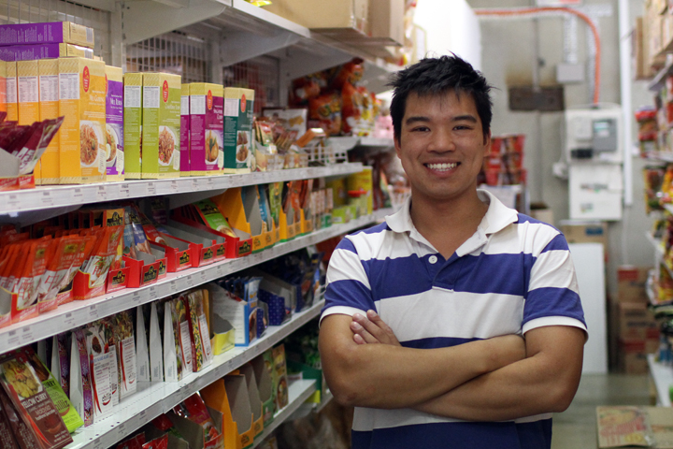
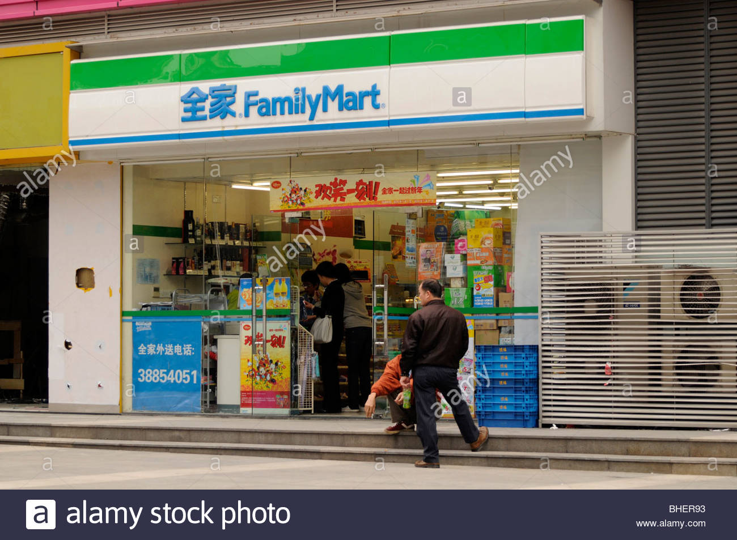
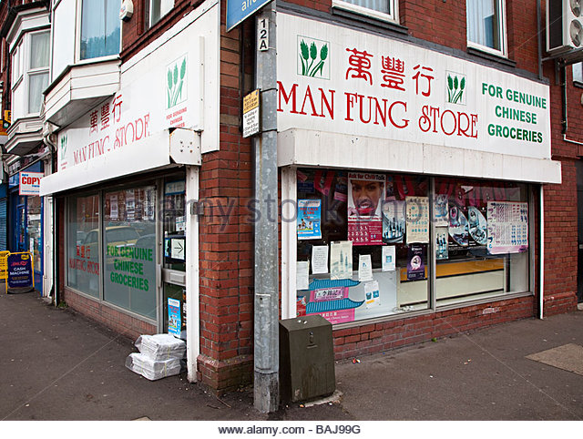
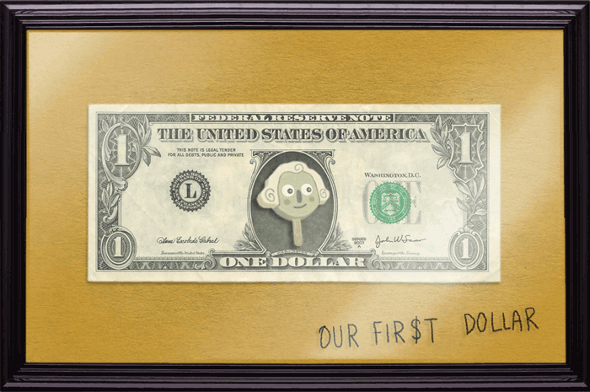
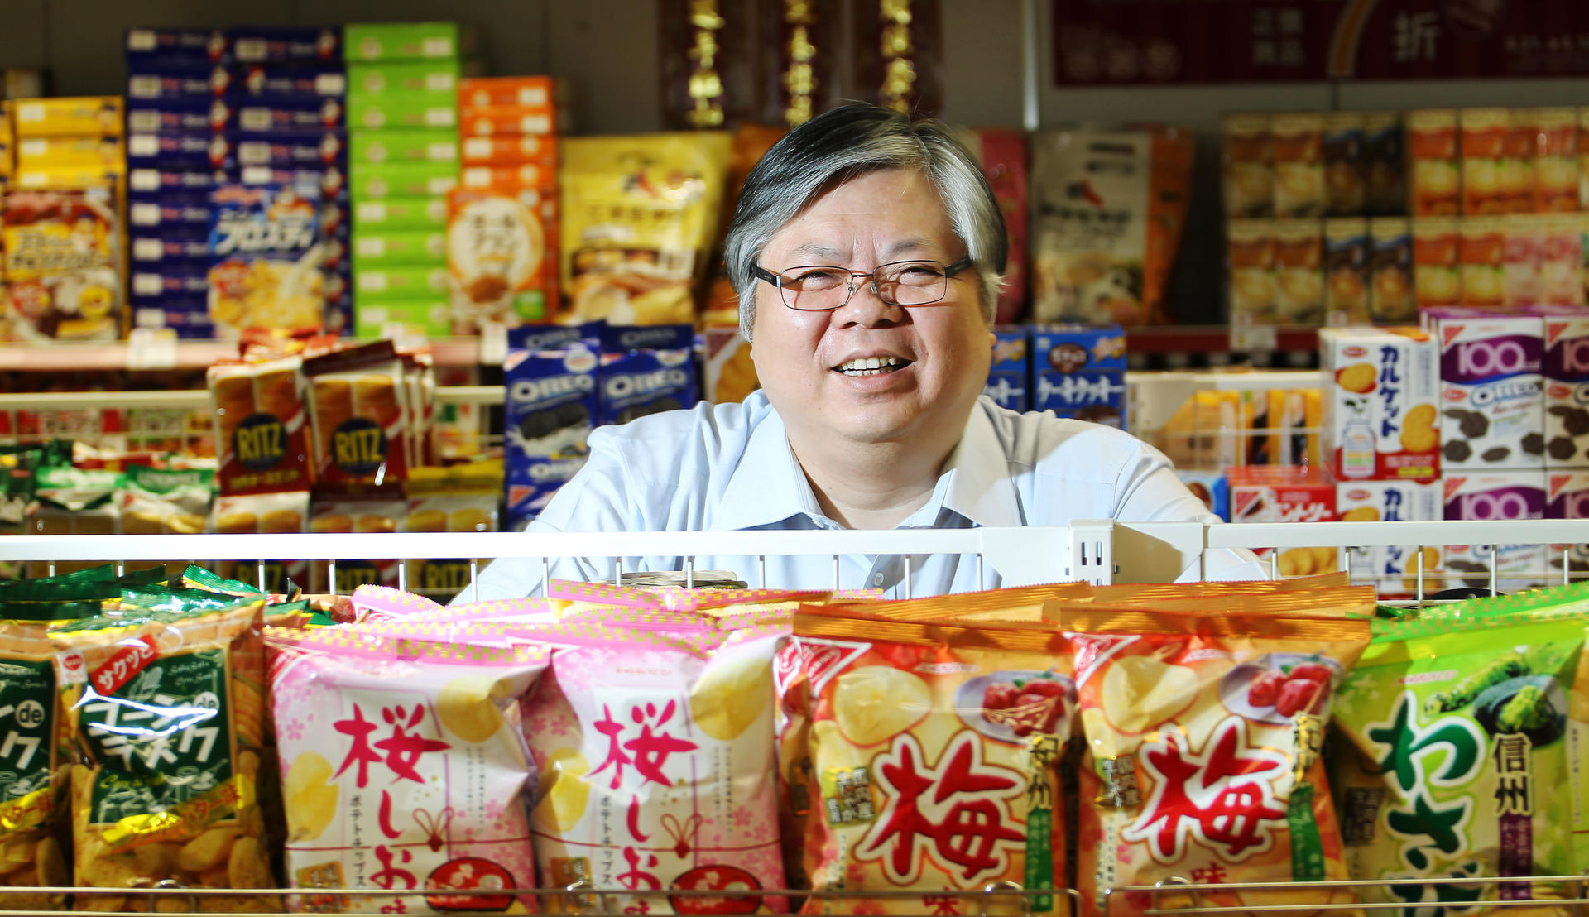
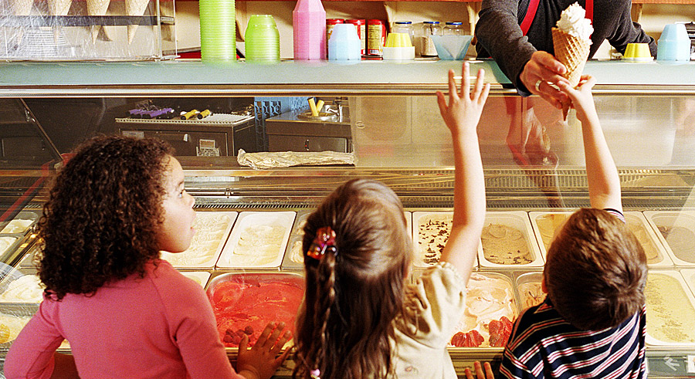
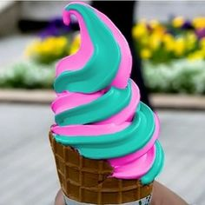
MarCom Visual Communication
Visual Communication
Images will include Chinese-American owned Convenience Stores, happy store owners
Ice cream, happy families eating ice cream, cash flying around, frugality

Slide 17
MarCom Messaging
Messages for Website and Blog:
Soft Serve Ice Cream Machines From China Cost Less
战略将是创建简单的销售网页
Improve Your Sales and Profit!
提高您的销售和利润！
Buy from a trusted Chinese American business owner.
从可信的中国美国企业主购买

Slide 18
MarCom Messaging
Messages for Website and Blog: Continued
Learn More
了解更多
Speak directly with Chinese-American Business Owner
直接与中美企业主说话
Ask Any Question
问任何问题

Slide 19
MarCom Messaging
Messages for Website and Blog: Continued
We make it easy to buy from China because you will have a U.S. based single point of contact familiar with business customs and languages in both China and The USA.
我们很容易从中国购买，因为您将有一个美国的单一联系人熟悉中国和美国的商业习俗和语言。
We make buying them simple, taking care of the import, delivery, and setup.
我们使他们购买简单，照顾进口，交货和设置

Slide 20
MarCom Messaging
Messages for Website and Blog: Continued
Visit our website and check our prices before you pay too much.
访问我们的网站并检查我们的价格之前，你付出太多
Sign Up for our newsletter to learn more about how you can add $2,000 per month in Soft Serve Ice Cream Sales to your Convenience Store.
注册我们的通讯，了解更多如何如何添加$ 2,000每月软冰淇淋销售到您的便利店
Read Chinese American Convenience Store Newsletter
阅读中国美国便利商店通讯

Slide 21
MarCom Messaging
Additional Message for general use and cross posting on other blogs:
Have you thought about adding Ice Cream to your Convenience Store?
你有想过在你的便利店里加冰淇淋吗？
Sweet Profit Item, Fun For All
甜利项目，所有的乐趣
Improve Your Sales and Profit!
提高您的销售和利润！

Slide 22
MarCom Messaging
Additional Message for general use and cross posting on other blogs: Continued
Add $24,000 A Year Extra Sales At Your Store!
在您的商店添加$ 24,000一年额外的销售！
Sales, Customer Support, and Service available in Chinese or American
销售，客户支持和服务中文或美国语言
Request More Information Now
现在可以索取更多的信息

Slide 23
MarCom Messaging
Additional Message for general use and cross posting on other blogs: Continued
Join Our Newsletter for Chinese American Owned Convenience Store Owners
加入我们的通讯，为了所有的美国华人便利店的店主们
Familiar with business customs and languages in both China and The USA.
熟悉中国和美国的商业习俗和语言

Slide 24
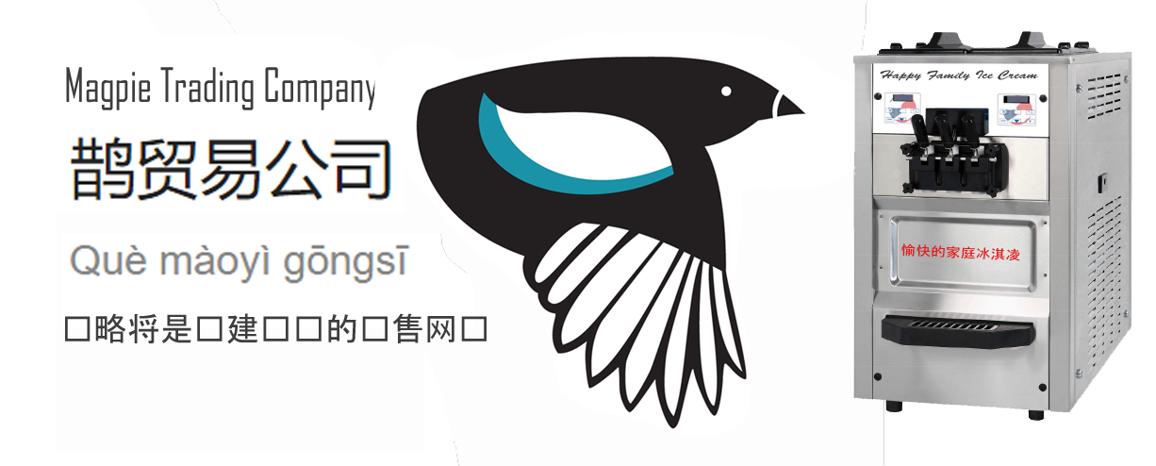
MarCom Implementation
Interactive Marketing: Facebook Page Header: See Facebook Page

